Slide 1
April 2021
Monthly Financial Report
by Jackie Loh

Slide 2
General Fund Revenues
33.3% of fiscal year complete; $17,945,000 in revenue received YTD – 34.2% of budgeted revenue
2021 YTD revenues are 8.4% above the 5 year YTD average

Slide 3
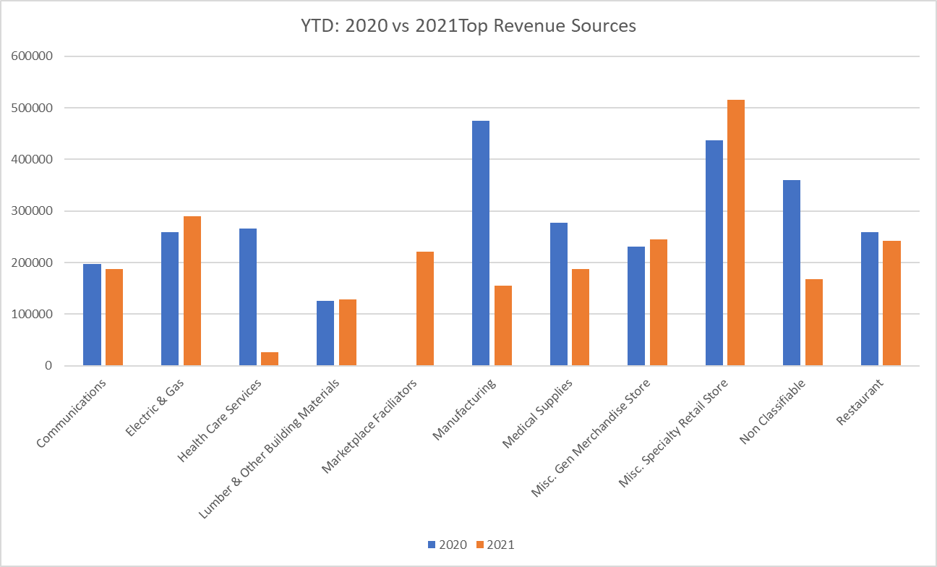
Sales and Use Tax Revenues
Top Ten Business Categories

Slide 4
Sales and Use Tax Revenues
2019 – 2021 Monthly Comparison

Slide 5
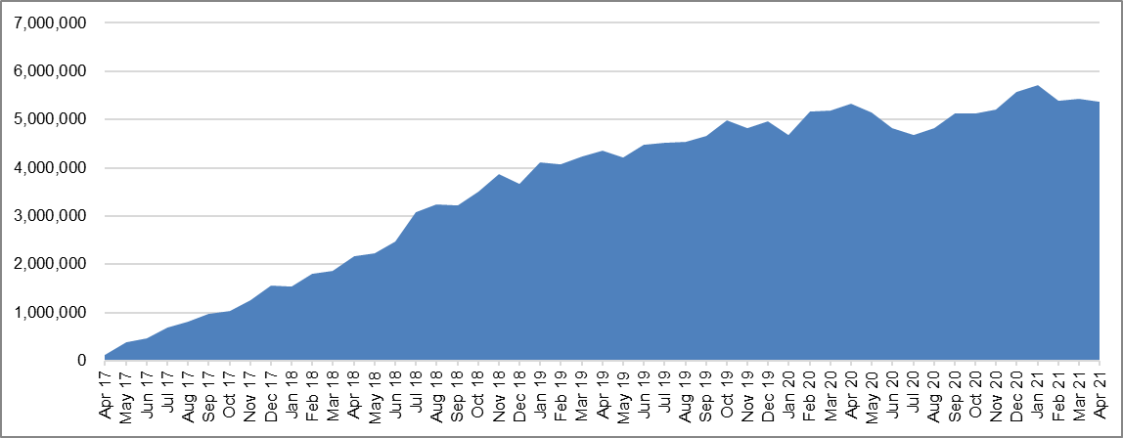

2017-2021 Cumulative Change in Sales and Use Tax Collected
$5.4 million increase since 2017

Slide 6
General Fund Expenditures
33.3% of the fiscal year is complete; YTD Expenditures of $18,196,000 – 31.0% of budgeted expenditures

Slide 7
General Fund Transfers

Slide 8
General Fund-Fund Balance Composition
(in millions)

Slide 9
YTD Sales & Use Collections by Area

Slide 10
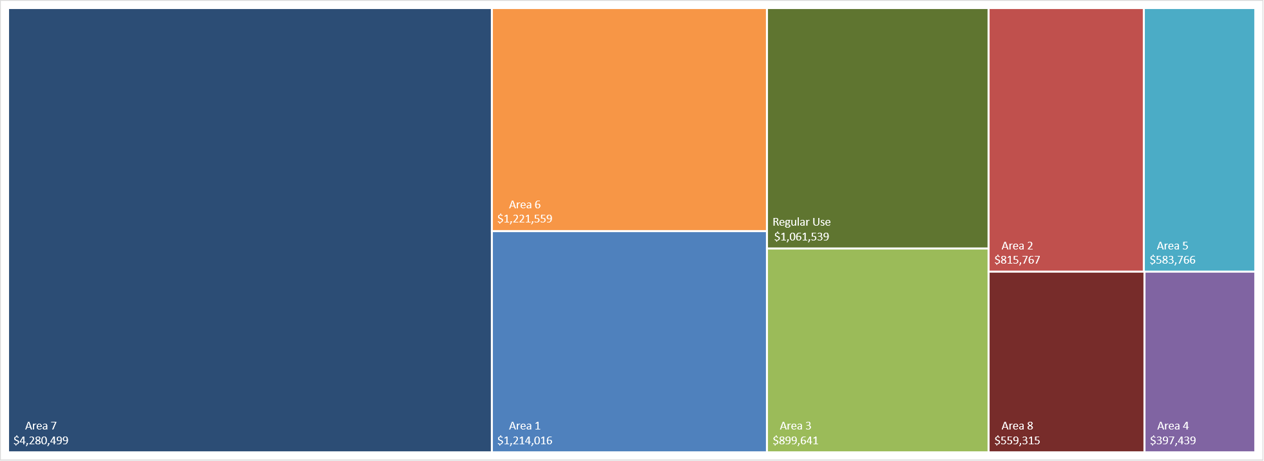
3 Year Avg YTD Sales Tax Collected by Area

Slide 11
Appendix
Area Sales Tax Slides

Slide 12
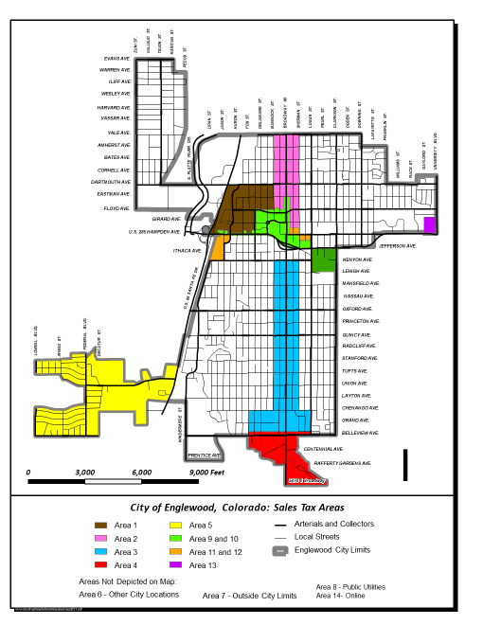
City of Englewood Sales Tax Area Map

Slide 13
YTD Sales & Use Tax Collections by Area

Slide 14
Area 1 Sales Tax
CityCenter (Formerly Cinderella City)

Slide 15
Area 2 Sales Tax
South of Yale, north & south side of Jefferson Ave/US 285 between Bannock and Sherman

Slide 16
Area 3 Sales Tax
S of Jefferson Ave/US 285 between Bannock & Sherman and north side of Belleview between Logan & Delaware

Slide 17
Area 4 Sales Tax
Broadway and Belleview (Between Fox and Sherman and south of Belleview and to the southern City Limits)

Slide 18
Area 5 Sales Tax
Area 5 - Federal and Belleview W of Santa Fe Drive

Slide 19
Area 6 Sales Tax
Area 6 - All other City locations

Slide 20
Area 7 Sales Tax
Area 7 - Outside City limits

Slide 21
Area 8 Sales Tax
Public Utilities

Slide 22
Area 13 Sales Tax
Area 13 - Hampden Avenue (US 285) and University Boulevard

Slide 23
Area 14 Sales Tax
Online Sales

Slide 24
Regular Use Tax

